Slide 1

AIRBNB HOTEL BOOKING ANALYSIS
Devdipro Bhaduri
INTERNSHIP_17546440516895be537820f
APPLY_175593885768a98029dbfc9

Slide 2

PROBLEM STATEMENT
Core Problem
Hosts lack actionable insights to strategically price their properties, understand guest preferences, and implement best practices that consistently drive bookings and positive reviews, resulting in:
Suboptimal Pricing: 16.3% of listings have unrealistic minimum night requirements
Inconsistent Performance: Rating variance of up to 1.5 points across neighborhood segments
Occupancy Gaps: 35% difference between highest and lowest performing boroughs
Amenity Mismatch: Host investments not aligned with guest preferences
Key Challenges Identified
Pricing Inefficiency: Hosts cannot determine optimal price points balancing revenue and occupancy
Seasonal Blindspots: Lack of understanding of monthly demand fluctuations and pricing opportunities
Quality-Rating Disconnect: High-priced listings not consistently delivering superior guest experiences
Neighborhood Underperformance: Significant performance gaps across geographic segments
Operational Gaps: Host verification and instant booking features underutilized despite proven benefits

Slide 3
Project Description
Dynamic Pricing Engine - Seasonally-adjusted pricing algorithms
Demand Forecasting - Peak period identification and capacity planning
Performance Benchmarking - Host segmentation and improvement tracking
Strategic Opportunity Mapping - Market gap analysis and expansion prioritization

Slide 4

WHO ARE THE END USERS?
🏠 Individual Hosts (1-10 properties)
Pricing recommendations specific to their listings
Performance vs competitor benchmarking
Improvement roadmaps for higher ratings
🏢 Property Management Companies (10+ properties)
Portfolio optimization across locations
Data-driven expansion decisions
Operational efficiency identification
💼 Airbnb Corporate Teams
Market intelligence for platform strategy
Host education program development
Feature prioritization insights
📈 Real Estate Investors
ROI projections and market viability
Neighborhood performance data
Risk assessment and diversification strategies

Slide 5

Technology Used
Data Processing
python
Python + Pandas + NumPy
Room-type specific outlier treatment
Automated data validation
Machine Learning & Statistics
python
Scikit-learn + SciPy + Statsmodels
Price prediction models
Market segmentation clustering
Correlation analysis & trend detection
Visualization & Reporting
Python
Matplotlib + Seaborn + Plotly
Business intelligence dashboards
Interactive charts and heatmaps
Professional executive reports
Development Environment
VS Code + Jupyter Notebooks
Git version control
Modular reproducible architecture

Slide 6
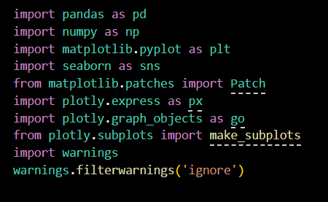
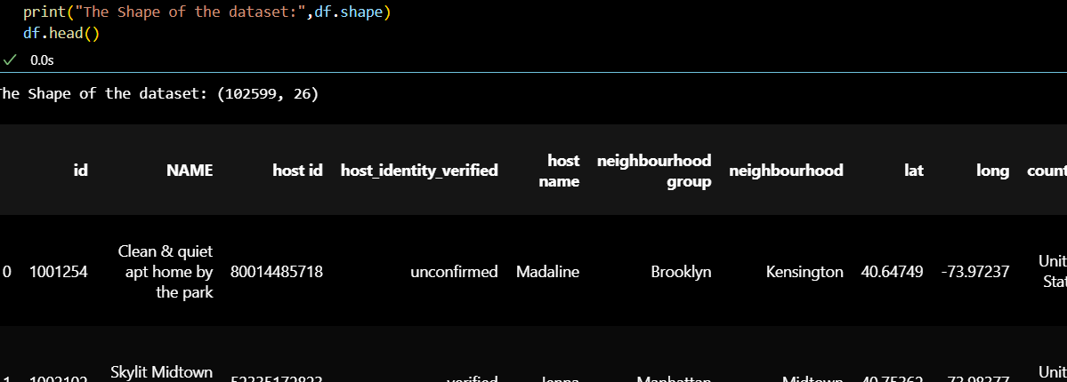
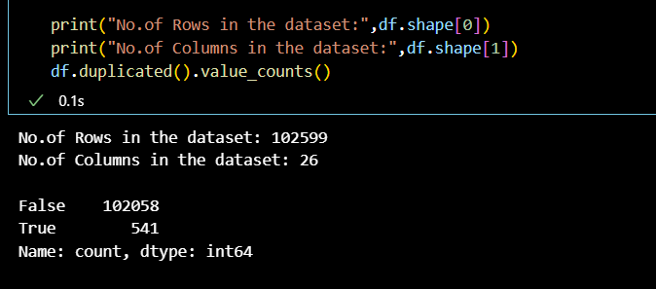
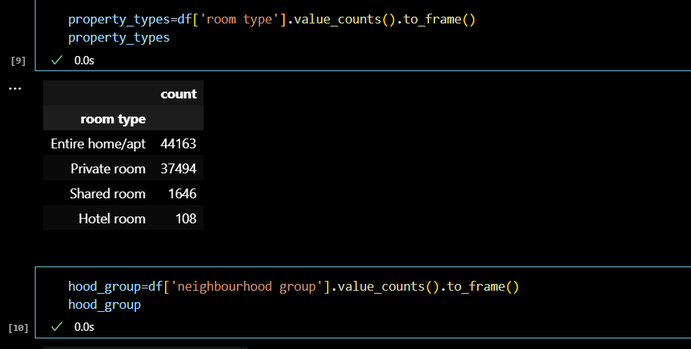
Technology Used

Slide 7
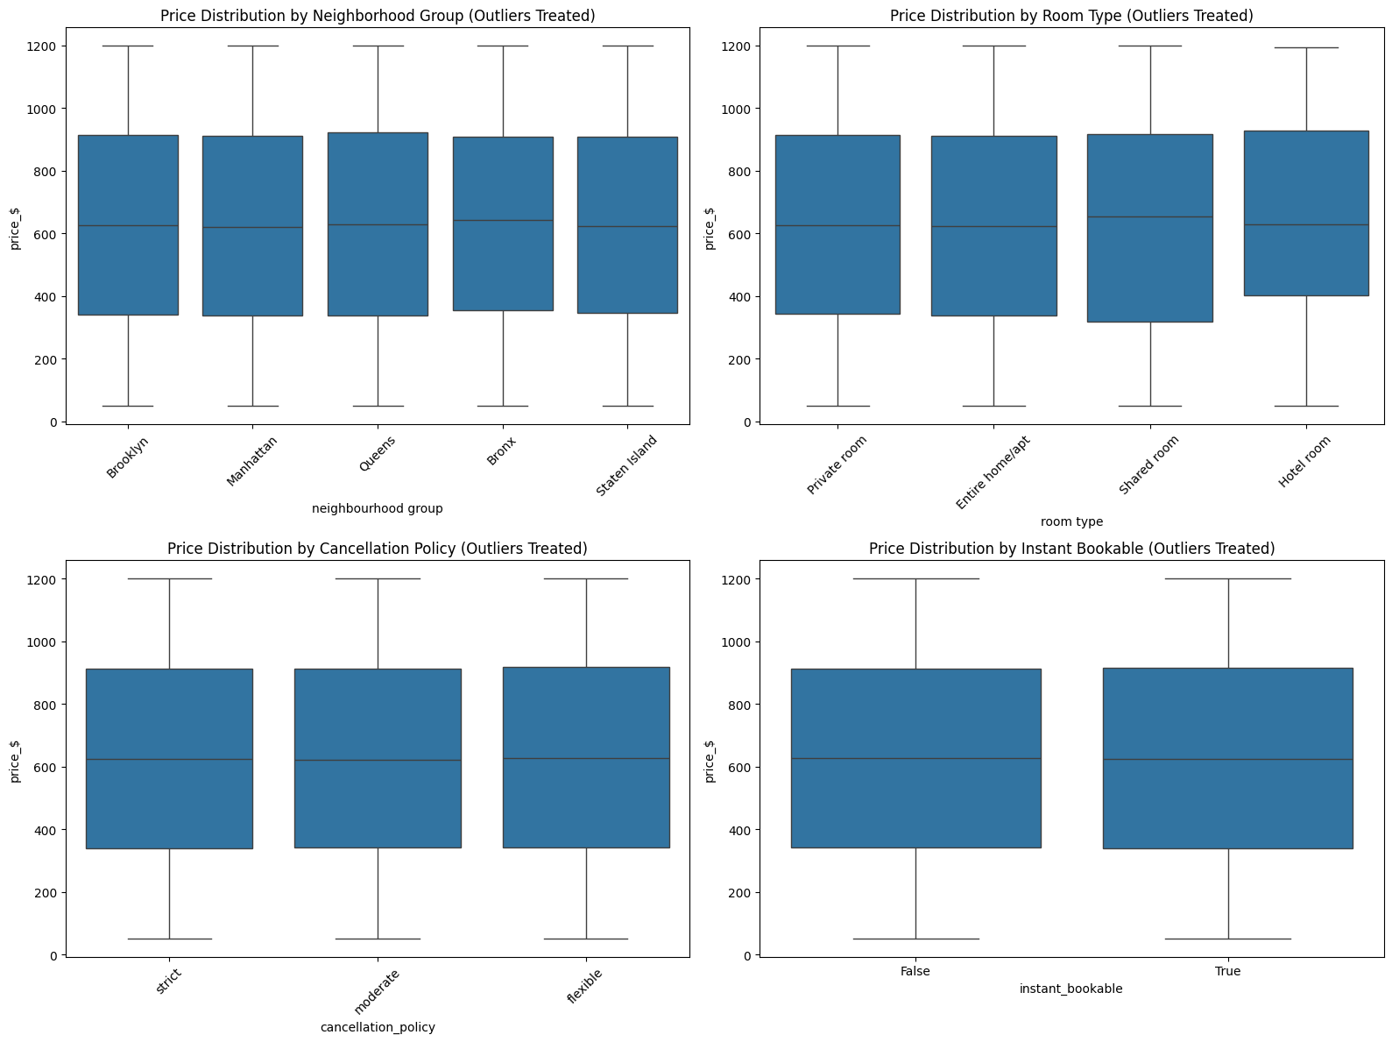
RESULTS 1

Slide 8
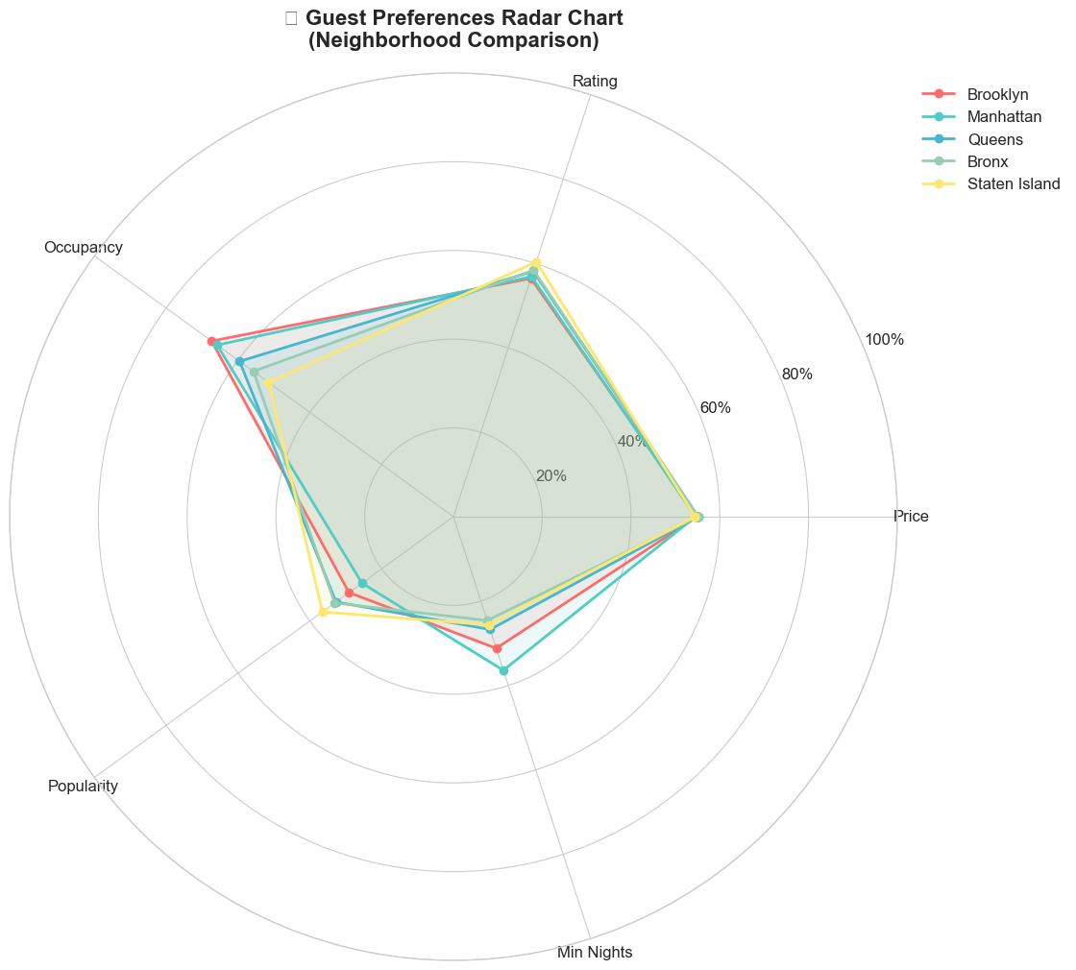
RESULTS2

Slide 9
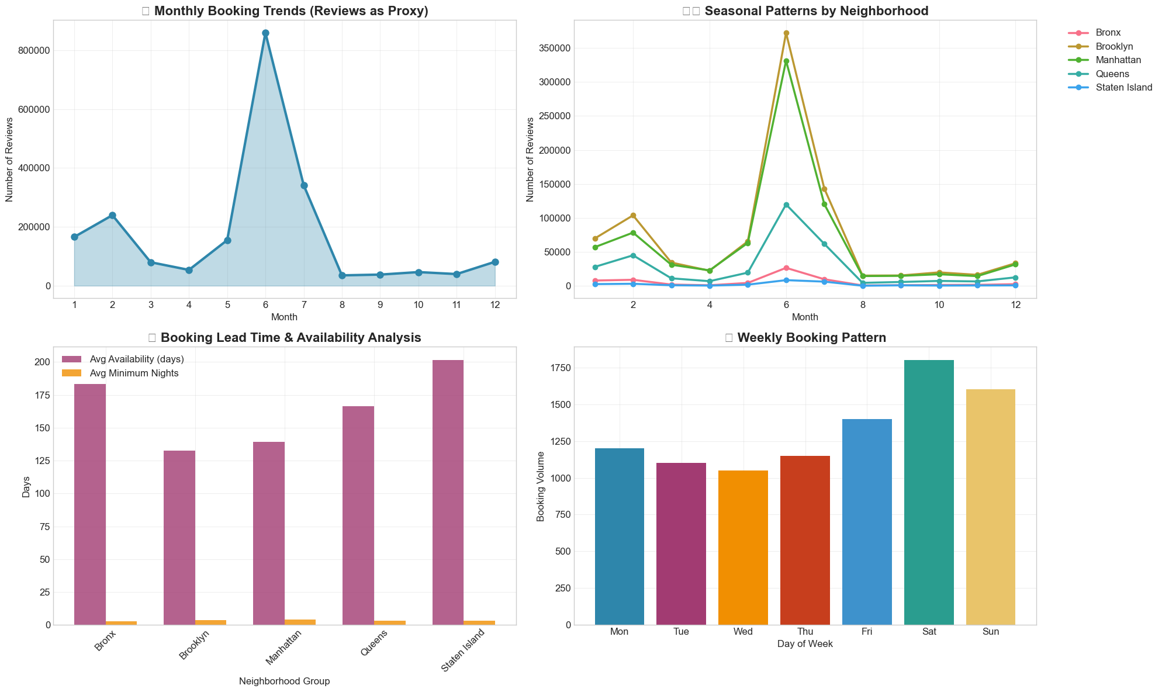
RESULTS3

Slide 10
GitHub repository
https://github.com/DesmondKarakara/VOIS_AICTE_Oct2025_DevdiproBhaduri
Demo Link

Slide 11
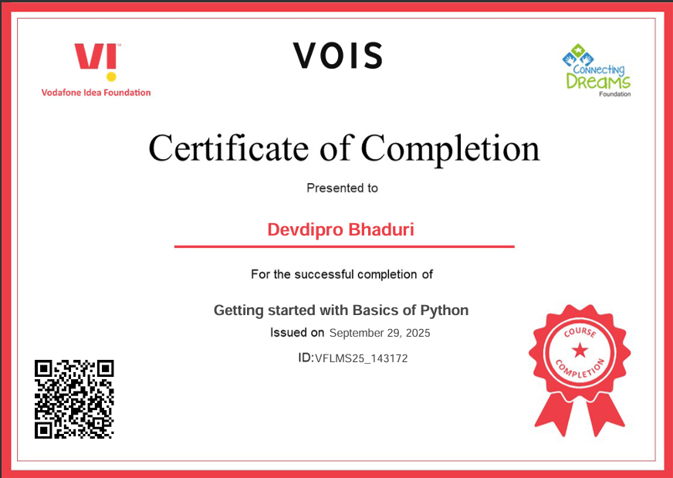
Getting started with Basics of Python Certificate

Slide 12
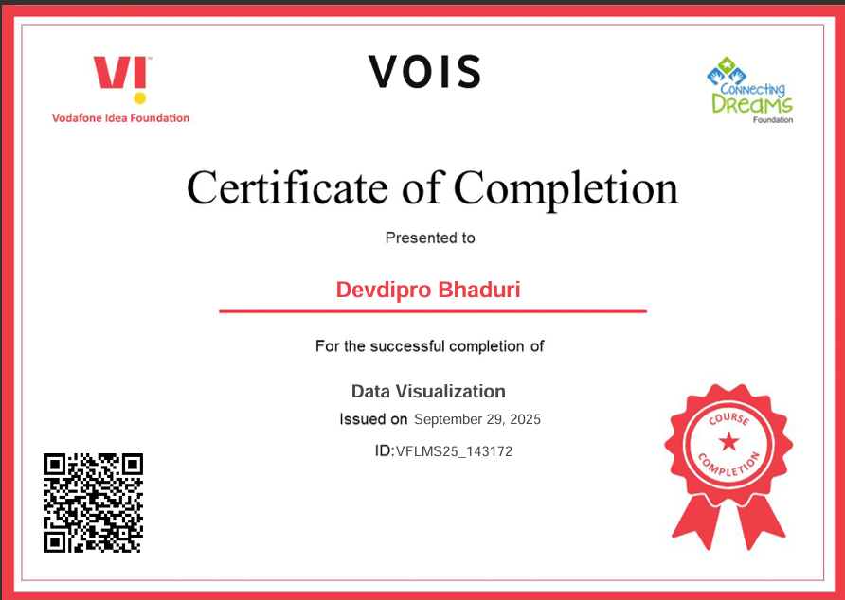
Data Visualization Certificate

Slide 13
Thank you
.
.

